Slide 1

DEPARTMENT OF COMPUTER SCIENCE AND ENGINEERING
Explainable Graph‑Based Framework for Twitter Bot Detection
Name of Students:
Abdul rahim S – 220171601003
Ajay M – 220171601012
Supervisor:
Dr.S.Subhashini Asst. Prof.
(Sr. Gr.) CSE
Domain of project: Artificial Intelligence and Machine learning

Slide 2
ABSTRACT
DEPARTMENT OF COMPUTER SCIENCE AND ENGINEERING
Twitter datasets have been loaded with multiple features that are unnecessary and computationally inefficient in order to train data for twitter user classification, Feature selection is therefore applied to eliminate noisy and unnecessary attributes, reduce computational overhead, and improve model efficiency while preserving accuracy through a informative feature representation.
Graph Neural Networks analyze user-to-user similarity relationships to detect coordinated bot activity and latent behavioral patterns.
The framework further identifies key behavioral and linguistic features influencing classification decisions and incorporates LLM summarization to explain about it.

Slide 3
PROBLEM STATEMENT
DEPARTMENT OF COMPUTER SCIENCE AND ENGINEERING
Current explainability methods introduce significant computational cost, making large-scale, real-time bot detection difficult.
Existing feature selection approaches increase computational cost, leading to suboptimal feature selection.
The absence of graph based analysis limits the model’s ability to capture complex behavioural relationships and generalization on unseen dataset.

Slide 4
RELATED WORK
DEPARTMENT OF COMPUTER SCIENCE AND ENGINEERING
Title | Author | Year | Journel | Limitation | Scope
Identification of spambots and fake followers on social network via interpretable AI-based machine learning | Javed et al | 2025 | IEEE Access | Relies on Cresci-15/17 only, so generalization to newer bot behaviors and other platforms may be limited. | Explains feature contributions clearly using SHAP and LIME, giving high interpretability for spambots and fake-follower detection.
Fine-tuned understanding: Enhancing social bot detection with transformer-based classification. | Sallah et al. | 2024 | IEEE Access | Transformer models are resource‑intensive and depend on specific training distributions. | Fine‑tuned PLMs (BERT/GPT‑style) significantly boost tweet‑level bot detection performance

Slide 5
DEPARTMENT OF COMPUTER SCIENCE AND ENGINEERING
Title | Author | Year | Journel | Limitations | Scope
A hybrid deep learning architecture for social media bots detection based on BiGRU-LSTM and GloVe word embedding | Ellaky et al. | 2024 | IEEE Access | High text‑only accuracy may drop on multimodal or unseen platforms. | Hybrid BiGRU‑LSTM with GloVe achieves very strong bot detection on Cresci‑2017 and Twibot‑20.
CrediBot: Applying bot detection for credibility analysis on Twitter. | Aguilera et al. | 2023 | IEEE Access | Uses older Cresci datasets and features, so performance may degrade as bots and Twitter APIs evolve. | Integrates bot detection directly into a real-time Twitter credibility model with strong Random Forest performance in English and Spanish.
Classifying social media bots as malicious or benign using semi-supervised machine learning. | Mbona and Eloff. | 2023 | Journal of cyber security | Semi‑supervised focus can struggle when reliable labeled data are very scarce. | Effectively separates benign vs malicious bots using selected behavioral features.

Slide 6
DEPARTMENT OF COMPUTER SCIENCE AND ENGINEERING
Title | Author | Year | Journal | Limitations | Scope
Enhancing social media bot detection with cross-feature gating and residual learning | Khan et al. | 2026 Journal: ICCK | ICCK | Evaluated on two merged Instagram datasets only, so robustness to other platforms and larger-scale data is unclear. | Introduces a strong tabular deep model with cross-feature gating and residual learning, achieving high accuracy on Instagram bots.
A global comparison of social media bot and human characteristics | Peng et al. | 2025 | Nature portfolio/ Scientific reports | Unsupervised assumptions may miss very stealthy or low-activity bots and can be sensitive to dataset-specific structures. | Proposes an unsupervised method that leverages structural information to detect bots without heavy labeling.
Improving social bot detection through aid and training | Kenny et al. | 2024 | Sage journal | Relies on specific platforms/tasks, so gains may not fully transfer to new bot types or low-resource settings. | Uses human-in-the-loop annotation and targeted training interventions to improve annotator skill and model robustness for social-bot detection.

Slide 7
DEPARTMENT OF COMPUTER SCIENCE AND ENGINEERING
Title | Author | Year | Journal | Limitations | Scope
Social media bot detection with deep learning methods: A systematic review | Hayawi et al. | 2023 | Springer nature | Covers work only up to 2021 and depends on heterogeneous evaluation setups, making direct metric comparison tricky. | Systematically reviews only deep-learning bot detectors and shows where DL clearly outperforms classical ML.
Detecting bots in social-networks using node and structural embeddings | Shi et al.. | 2023 | Springer nature | Depends on good graph structure and labeled graphs; performance may drop when network data is sparse or noisy. | Uses graph data augmentation and stacked GNNs to capture both homophilic and heterophilic patterns in Twitter bot networks.
Machine learning-based social media bot detection: A comprehensive literature review | Aljabri et al. | 2023 | Springer nature | Focuses on 2015–2022 literature, so very recent GNN/LLM-based detectors and new benchmarks are underrepresented. | Provides a broad ML-based bot-detection survey across multiple platforms, methods, features, and datasets.

Slide 8
PROPOSED WORK
DEPARTMENT OF COMPUTER SCIENCE AND ENGINEERING
To develop an computationally efficient, and graph-enhanced bot detection model with high interpretability.
Live user features are collected from the Twitter (X), including profile metadata, posting behavior, and content-related attributes.
Bot/Human classification with explainability showing feature contributions and LLM summary.
kNN, GraphSAGE, Random Forest, LIME, MI Info classification.
Reduce computational costs Capture most informative features. Implicit relational analysis via user similarity graphs. Make interpretability results more understandable.
Objective
Input
Output
Algorithm Used
Scope

Slide 9
EXISTING SYSTEM
DEPARTMENT OF COMPUTER SCIENCE AND ENGINEERING
The Existing System proposes a model using Explainability AI to detect spambots on X, enhancing transparency over black-box methods.
The system extracts profile, content, linguistic, engagement, sentiment and tests on Cresci-15/17 datasets with cross-validation.
It uses SHAP-based feature importance to select the most relevant features for model training.

Slide 10
PROPOSED SYSTEM
DEPARTMENT OF COMPUTER SCIENCE AND ENGINEERING
The proposed system performs feature engineering and mutual information–based, tree importance feature selection to refine user and behavioral attributes into a informative feature set, improving model stability and generalization.
GraphSAGE learn the similarity-based relationships, generating embeddings that capture network behavior patterns to improve bot detection.
LIME provide transparent decision-making by highlighting influential features and interactions, while the LLM is used to give a summarization of LIME output.

Slide 11
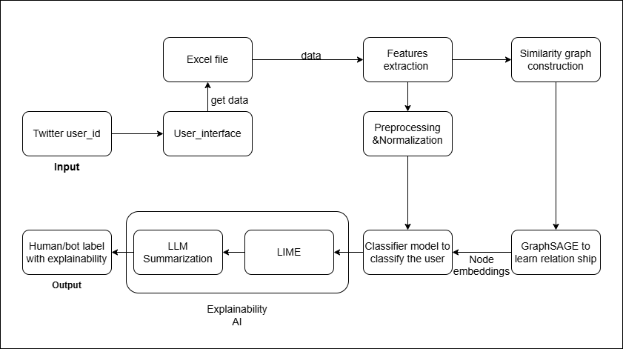
ARCHITECTURE DIAGRAM
DEPARTMENT OF COMPUTER SCIENCE AND ENGINEERING

Slide 12
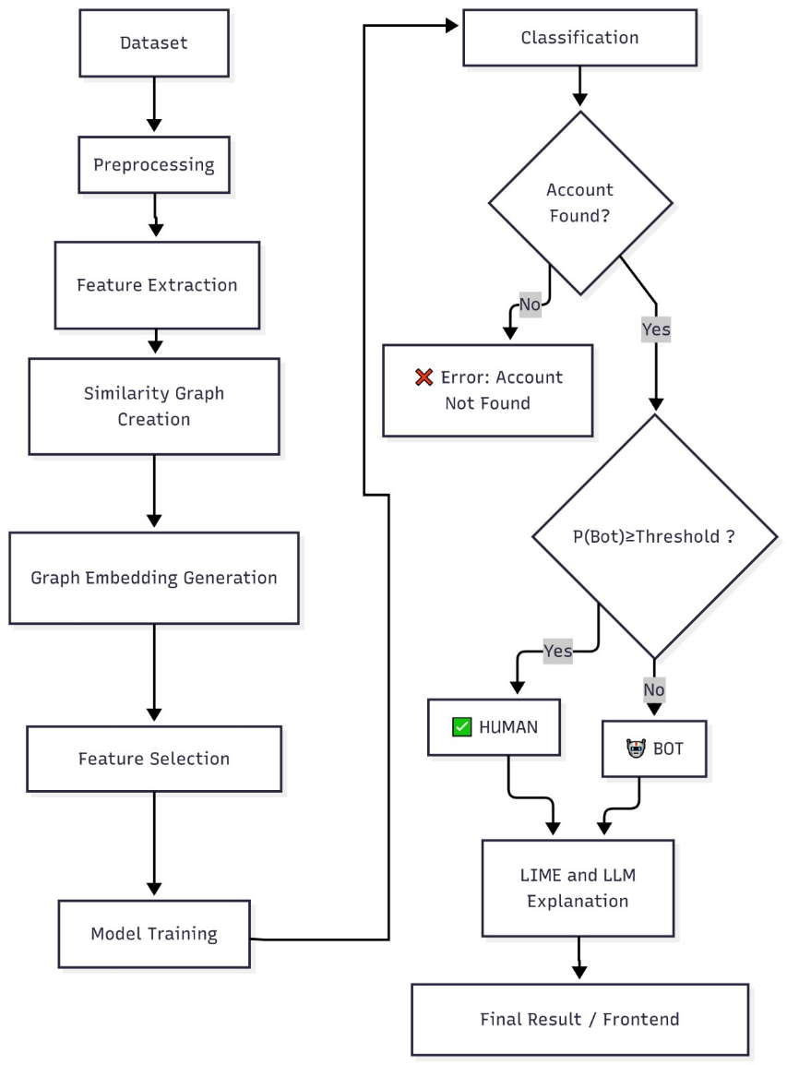
Workflow diagram
DEPARTMENT OF COMPUTER SCIENCE AND ENGINEERING

Slide 13
INPUT
DEPARTMENT OF COMPUTER SCIENCE AND ENGINEERING
User fields:
User_id
username
created_at
verified
description
location
url
profile_image_url
followers_count
following_count
tweet_count
listed_count
Tweet fields:
User_id
text
Num_hashtags
Num_mentions
Num_urls
retweet_count
reply_count

Slide 14
OUTPUT
DEPARTMENT OF COMPUTER SCIENCE AND ENGINEERING
Human or Bot.
Explainability provided by LIME.
LLM summarization of LIME output.

Slide 15
MODULES
DEPARTMENT OF COMPUTER SCIENCE AND ENGINEERING
Data Collection & Preprocessing Module
Graph Construction Module
Classification Module
Model Interpretation Module
Evaluation Metrics Module

Slide 16
MODULES DESCRIPTION
DEPARTMENT OF COMPUTER SCIENCE AND ENGINEERING
Data Collection & Preprocessing Module
Dataset Integration: Imported Cresci-17 and Twibot-22 datasets; extracted user, content, and interaction data with unified schemas for extensibility.
Feature Engineering: Derived meaningful behavioral, profile, and activity-based features, and temporal patterns to enhance the representation of user behavior for effective bot detection.
Cleaning & Text Processing: Handled missing values, noise, and normalization; performed tokenization, stopword removal, and embedding preparation.

Slide 17
DEPARTMENT OF COMPUTER SCIENCE AND ENGINEERING
2. Graph Construction Module
Construct similarity-based user graphs using k-Nearest Neighbors and cosine similarity on normalized features.
Apply GraphSAGE to learn node embeddings that capture user attributes and neighborhood similarity.
Generate graph-informed representations for downstream bot classification
3. Classification Module
Classification & Inference : Random Forest model for bot–human classification using combined feature and similarity representations, supporting batch and near real-time inference.

Slide 18
DEPARTMENT OF COMPUTER SCIENCE AND ENGINEERING
4. Model Interpretation Module
Apply LIME to identify feature-level contributions.
Used LLM to summarize the LIME output for explainability
5. Evaluation Metrics Module
Evaluate using accuracy, precision, recall, F1-score, and AUC
Cross-dataset testing for generalization (Cresci ↔ Twibot)
Assess robustness to unseen and adapting bot behaviors

Slide 19
ALGORITHMS USED
DEPARTMENT OF COMPUTER SCIENCE AND ENGINEERING
k-Nearest Neighbors
GraphSAGE
Random Forest
MI classification
LIME

Slide 20
Algorithmic description
DEPARTMENT OF COMPUTER SCIENCE AND ENGINEERING
k-Nearest Neighbors (kNN)
Constructs similarity graphs by linking users with similar feature representations.
Uses cosine similarity on normalized user attributes.
Enables modeling of implicit relationships without explicit follower graphs.
GraphSAGE
Learns node embeddings by aggregating information from similar users
Captures both individual attributes and neighborhood similarity
Supports scalable graph representation learning for large datasets

Slide 21
DEPARTMENT OF COMPUTER SCIENCE AND ENGINEERING
Random Forest
Ensemble of decision trees for robust bot classification
Handles non-linear feature interactions effectively
Provides stable performance and serves as a strong baseline model
Mutual information selection
Measures statistical dependency between each feature and the target label.
Ranks features by information gain to retain the most predictive signals.
Reduces dimensionality while preserving discriminative power for classification.

Slide 22
DEPARTMENT OF COMPUTER SCIENCE AND ENGINEERING
LIME
Generates local surrogate models to explain individual predictions.
Perturbs input features to estimate their influence on outputs.
Provides human-interpretable insights for complex black-box models.

Slide 23
DEPARTMENT OF COMPUTER SCIENCE AND ENGINEERING
Proposed algorithm
Input: User ID
Output: Account classification Whether Human or Bot with Explanation.
Step 1 : Start
Step 2 : Get user id and extract twitter raw profile metadata and activity based attributes.
Step 3 : Preprocess input data, Clean the data, handle missing values.
Step 4 : Perform feature engineering to compute behavioral attributes.
Step 5 : Identify similar accounts using K-Nearest Neighbors based on feature similarity
Step 6 : Generate graph-based embedding by aggregating precomputed GraphSAGE embeddings of similar accounts.
Step 7 : Combine traditional machine learning features with the generated graph embeddings to form a hybrid feature set.

Slide 24
DEPARTMENT OF COMPUTER SCIENCE AND ENGINEERING
Step 8 : Apply scaling and normalization using pre-trained scalers.
Step 9 : Select required features based on pre-trained feature list.
Step 10 : Apply the trained model to classify accounts as bot or human using probability thresholds.
Step 11 : Apply the LIME explainability method to identify the most influential features.
Step 12 : Generate natural language explanation using LLM.
Step 13 : Display classification result and explanation.
Step 14 : Stop

Slide 25
DEPARTMENT OF COMPUTER SCIENCE AND ENGINEERING
Evaluation metric
Model | Setup | Accuracy | Precision | Recall | F1 | AUC
XGBoost | ML only | 0.9395 | 0.9327 | 0.8616 | 0.8957 | 0.9718
XGBoost | Embeddings only | 0.9407 | 0.9417 | 0.8566 | 0.8971 | 0.9720
XGBoost | ML + Embeddings | 0.9442 | 0.9448 | 0.8657 | 0.9035 | 0.9750
RandomForest | ML only | 0.9422 | 0.9586 | 0.8450 | 0.8982 | 0.9725
RandomForest | Embeddings only | 0.9420 | 0.9509 | 0.8516 | 0.8986 | 0.9731
RandomForest | ML + Embeddings | 0.9435 | 0.9545 | 0.8533 | 0.9011 | 0.9755

Slide 26
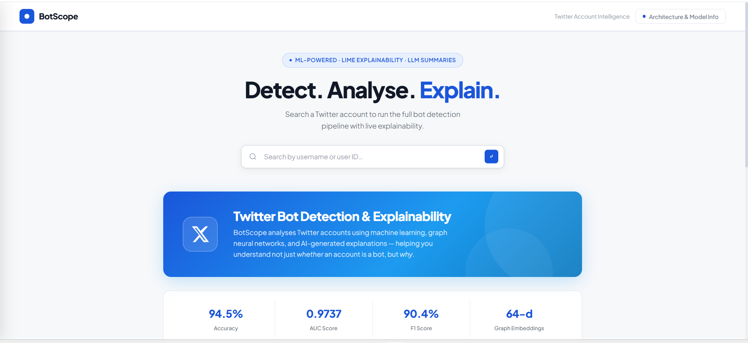
DEPARTMENT OF COMPUTER SCIENCE AND ENGINEERING
Frontend Input page

Slide 27
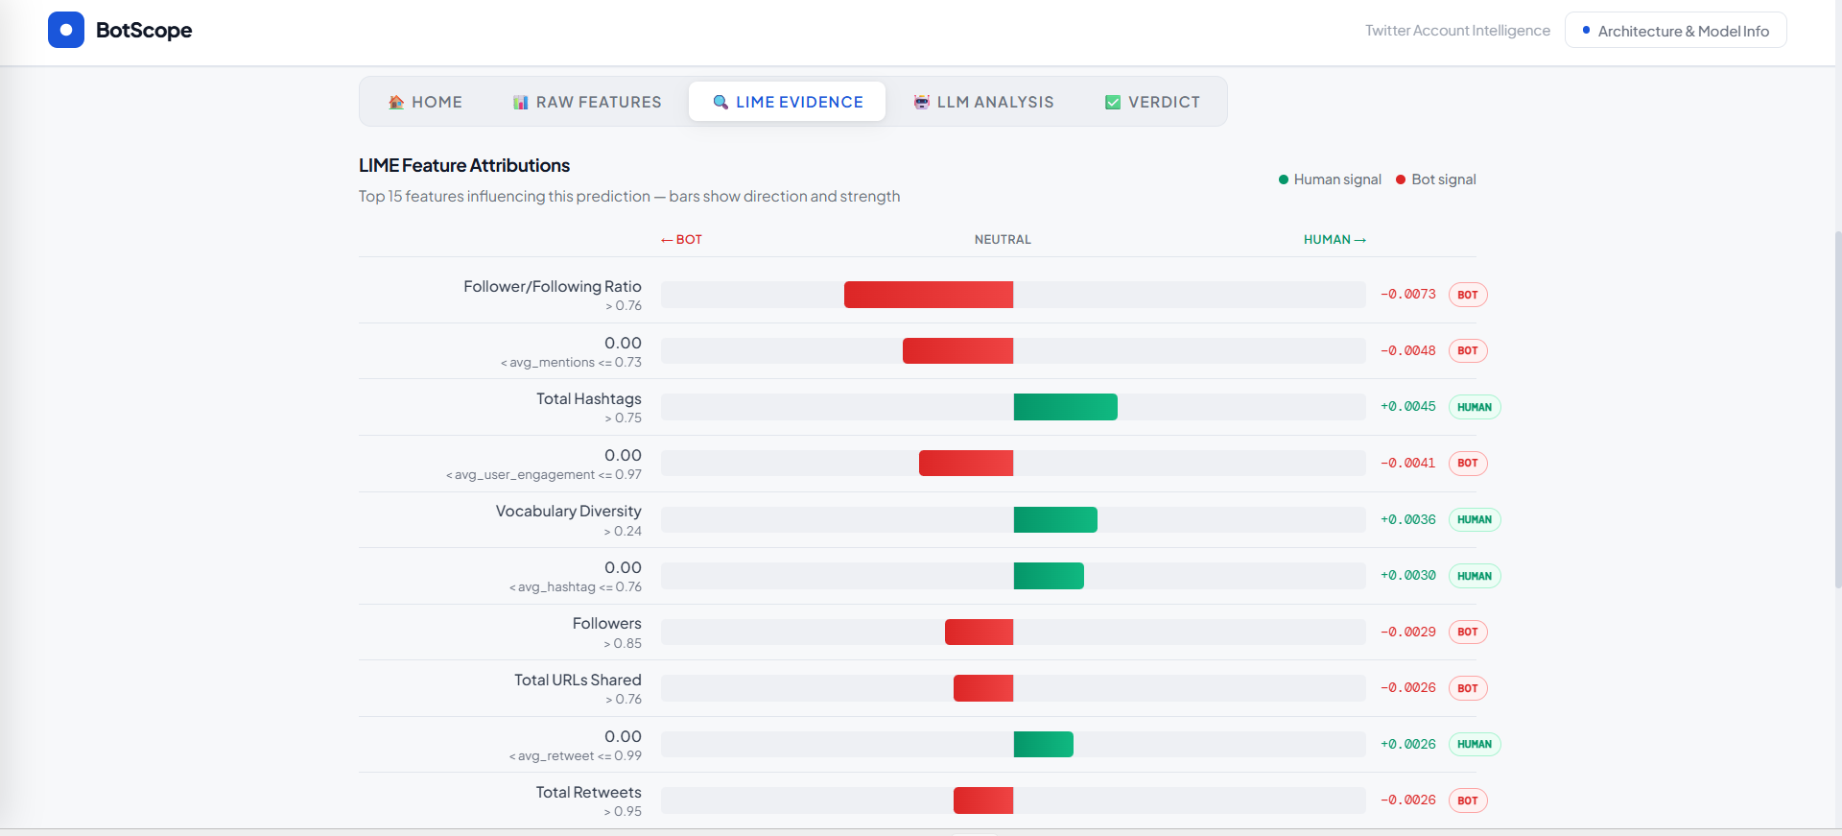
DEPARTMENT OF COMPUTER SCIENCE AND ENGINEERING
Lime output

Slide 28
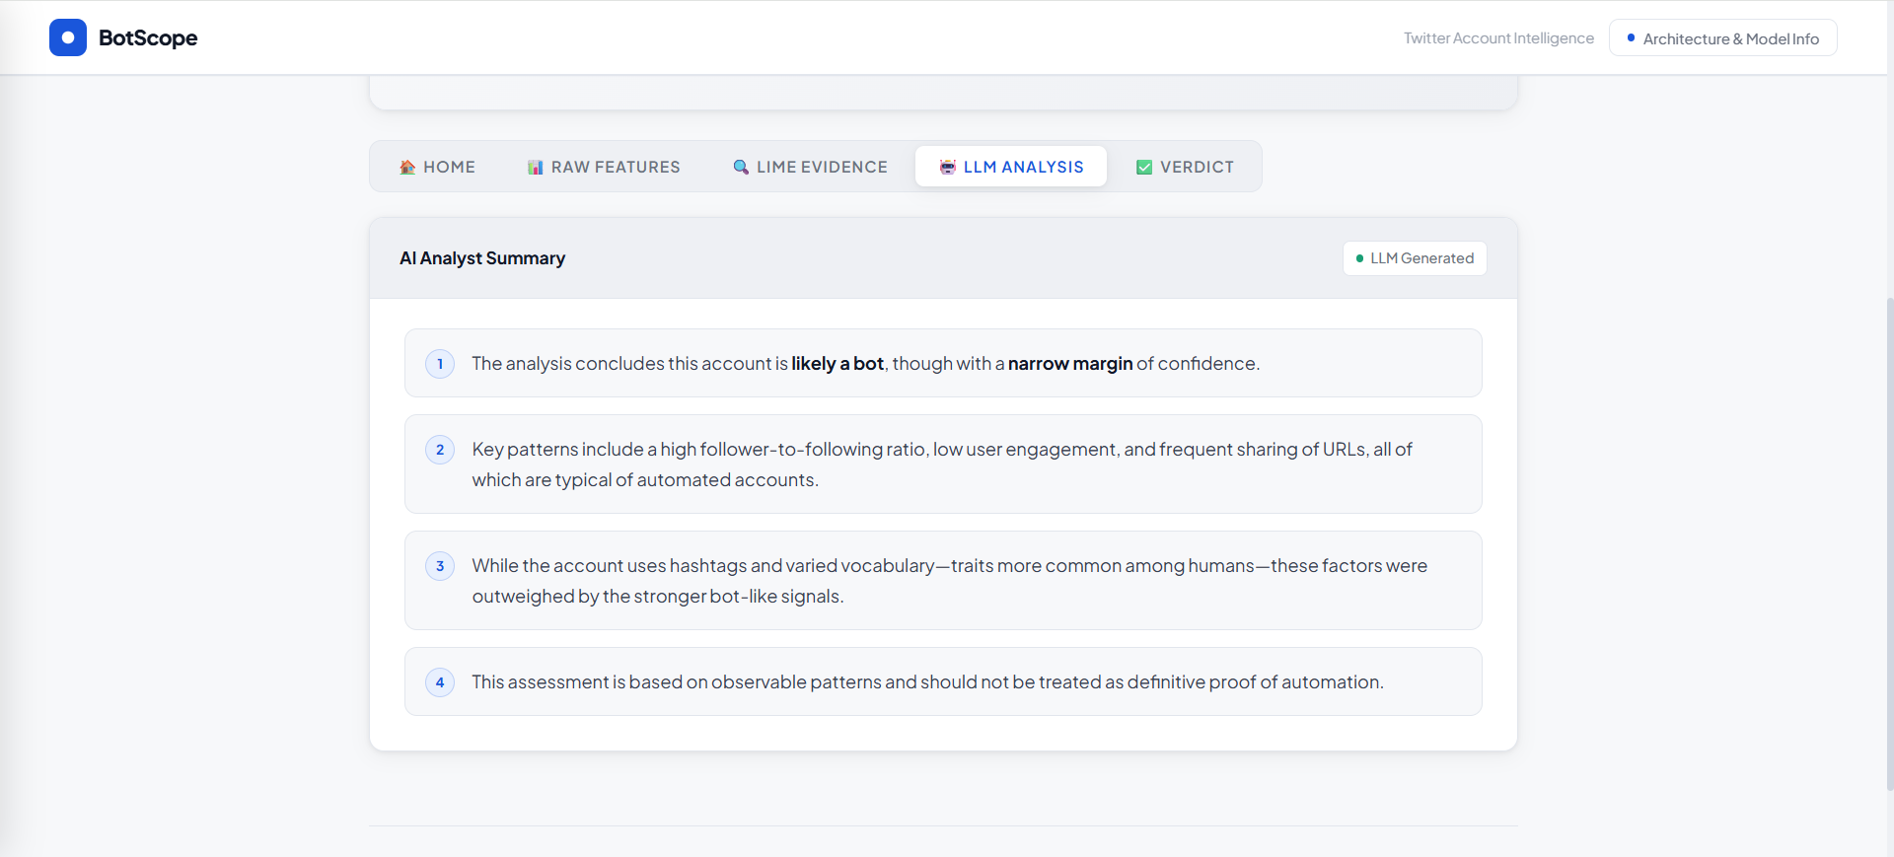
DEPARTMENT OF COMPUTER SCIENCE AND ENGINEERING
LLM Summary

Slide 29

DEPARTMENT OF COMPUTER SCIENCE AND ENGINEERING
VERDICT

Slide 30
DEPARTMENT OF COMPUTER SCIENCE AND ENGINEERING
Future work
Using Twitter/X API and enable continuous model learning to handle evolving bot behavior.
Expand features like images, videos, metadata and accessing post urls.
Extension of the framework to additional platforms such as Instagram and Reddit, supported by the existing modular pipeline architecture

Slide 31
REFERENCES
DEPARTMENT OF COMPUTER SCIENCE AND ENGINEERING
D. Javed, N. Z. Jhanjhi, N. A. Khan, S. K. Ray, A. Al-Dhaqm, and V. R. Kebande, “Identification of spambots and fake followers on social network via interpretable AI-based machine learning,” IEEE Access, vol. 13, pp. 52246–52259, 2025, doi: 10.1109/ACCESS.2025.3551993.​
A. Khan, A. Fatima, R. Jamil, H. Ahmed, and A. Saba, “Enhancing social media bot detection with cross-feature gating and residual learning,” ICCK Trans. Emerg. Top. Artif. Intell., vol. 3, no. 1, pp. 20–32, 2026, doi: 10.62762/TETAI.2025.791029.​
L. H. X. Ng and K. M. Carley, “A global comparison of social media bot and human characteristics,” Sci. Rep., vol. 15, no. 10973, pp. 1–18, 2025, doi: 10.1038/s41598-025-96372-1.​
A. Sallah, S. Agoujil, M. A. Wani, M. Hammad, Y. Maleh, and A. A. Abd El-Latif, “Fine-tuned understanding: Enhancing social bot detection with transformer-based classification,” IEEE Access, vol. 12, pp. 118250–118269, 2024, doi: 10.1109/ACCESS.2024.1234567.​
Z. Ellaky, F. Benabbou, Y. Matrane, and S. Qaqa, “A hybrid deep learning architecture for social media bots detection based on BiGRU-LSTM and GloVe word embedding,” IEEE Access, vol. 12, pp. 100278–100292, 2024, doi: 10.1109/ACCESS.2024.3430859.

Slide 32
DEPARTMENT OF COMPUTER SCIENCE AND ENGINEERING
R. Kenny, B. Fischhoff, A. Davis, and C. Canfield, “Improving social bot detection through aid and training,” Human Factors, vol. 66, no. 10, pp. 2323–2344, 2024, doi: 10.1177/00187208231210145.​
K. Hayawi, S. Saha, M. M. Masud, S. S. Mathew, and M. Kaosar, “Social media bot detection with deep learning methods: A systematic review,” Neural Comput. Appl., vol. 35, pp. 8903–8918, 2023, doi: 10.1007/s00521-023-08352-z.​
A. Aguilera, P. Quinteros, I. Dongo, and Y. Cardinale, “CrediBot: Applying bot detection for credibility analysis on Twitter,” IEEE Access, vol. 11, pp. 108365–108380, 2023, doi: 10.1109/ACCESS.2023.3320687.
A. Dehghan et al., “Detecting bots in social-networks using node and structural embeddings,” J. Big Data, vol. 10, no. 119, pp. 1–37, 2023, doi: 10.1186/s40537-023-00796-3.
I. Mbona and J. H. P. Eloff, “Classifying social media bots as malicious or benign using semi-supervised machine learning,” J. Cybersecur., vol. 9, no. 1, Art. no. tyac015, 2023, doi: 10.1093/cybsec/tyac015.​
M. Aljabri, R. Zagrouba, A. Shaahid, F. Alnasser, A. Saleh, and D. M. Alomari, “Machine learning-based social media bot detection: A comprehensive literature review,” Soc. Netw. Anal. Min., vol. 13, no. 20, pp. 1–40, Jan. 2023, doi: 10.1007/s13278-022-01020-5.

